Slide 1
22CS304 – Operating Systems
UNIT I INTRODUCTION TO OPERATING SYSTEMS AND PROCESSES
Introduction to OS –Computer system organization - architecture – Resource management - Protection and Security – Virtualization - Operating System Structures - Services - User and Operating-System Interface - System Calls - System Services - Design and Implementation - Building and Booting an Operating System - Process Concept - Process Scheduling - Operations on Processes – Inter process Communication - IPC in Shared-Memory Systems - IPC in Message-Passing Systems
UNIT II THREADS AND CPU SCHEDULING
Threads & Concurrency: Overview - Multicore Programming - Multithreading Models - Thread Libraries - Implicit Threading - Threading Issues - CPU Scheduling: Basic Concepts - Scheduling Criteria - Scheduling Algorithms - Thread Scheduling - Multi- Processor Scheduling - Real-Time CPU Scheduling
UNIT III PROCESS SYNCHRONISATION AND DEADLOCKS
Process Synchronization - The critical-section problem, Peterson’s Solution - Synchronization hardware, Mutex locks, Semaphores, monitors, Liveness - Classic problems of synchronization – Bounded Buffer Problem - Reader’s & Writer Problem, Dinning Philosopher Problem, Barber’s shop problem. Deadlock - System model - Deadlock characterization, Methods for handling deadlocks - Deadlock prevention - Deadlock avoidance - Deadlock detection - Recovery from deadlock
UNIT IV MEMORY MANAGEMENT
Memory Management: Contiguous Memory Allocation - Paging - Structure of the Page Table – Swapping - Virtual Memory: Demand Paging – Copy-on write – Page Replacement – Allocation of frames – Thrashing Memory – Compression
UNIT V FILE MANAGEMENT
File Management: File Concept – Access Methods – Directory Structure – Protection - Memory-Mapped File - Disk Management: Disk structure, Disk scheduling - FCFS, SSTF, SCAN, C-SCAN, Disk reliability, Disk formatting, Boot-block, Bad blocks - I/O Hardware: I/O devices, Device controllers, Direct Memory Access - Case Study-Linux.

Slide 2
Unit IV – MEMORY MANAGEMENT
Overview
MAIN MEMORY
Memory is central to the operation of a modern computer system.
Memory consists of a large array of bytes, each with its own address.
The CPU fetches instructions from memory according to the value of the program counter.
These instructions may cause additional loading from and storing to specific memory addresses.
A typical instruction-execution cycle, for example,
First fetches an instruction from memory.
The instruction is then decoded and may cause operands to be fetched from memory. After the instruction has been executed on the operands, results may be stored back in memory.
The memory unit sees only a stream of memory addresses.

Slide 3
Unit IV – MEMORY MANAGEMENT
Overview
Program must be brought (from disk) into memory and placed within a process for it to be run
Main memory and registers are only storage CPU can access directly
Memory unit only sees a stream of addresses + read requests, or address + data and write requests
Register access in one CPU clock (or less)
Main memory can take many cycles, causing a stall
Cache sits between main memory and CPU registers
Protection of memory required to ensure correct operation

Slide 4
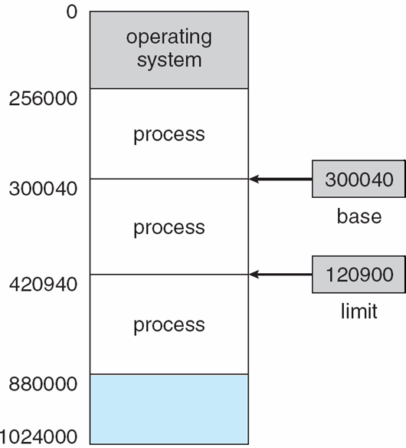
Unit IV – MEMORY MANAGEMENT
Overview - – Base and Limit Registers
A pair of base and limit registers define the logical address space
CPU must check every memory access generated in user mode to be sure it is between base and limit for that user
.

Slide 5
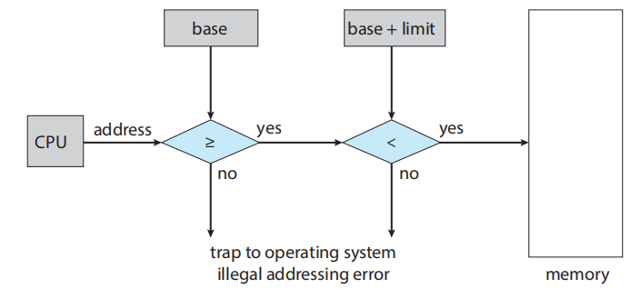
Unit IV – MEMORY MANAGEMENT
Overview – Base and Limit Registers
The base and limit registers can be loaded only by the operating system, which uses a special privileged instruction.
Privileged instructions can be executed only in kernel mode, and since only the operating system executes in kernel mode, only the operating system can load the base and limit registers.
The operating system, executing in kernel mode, is given unrestricted access to both operating-system memory and users’ memory as shown in Figure.

Slide 6
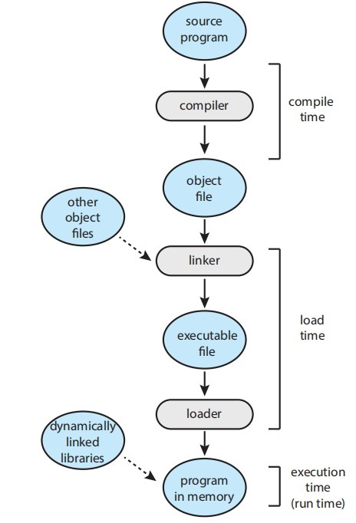
Unit IV – MEMORY MANAGEMENT
Overview – Address Binding
Address Binding
Usually, a program resides on a disk as a binary executable file.
To be executed, the program must be brought into memory and placed within a process.
Depending on the memory management in use, the process may be moved between disk and memory during its execution as shown in the figure.
Compile time: At compile time if known where the process will reside in memory, then absolute code can be generated.
Load time. If it is not known at compile time where the process will reside in memory, then the compiler must generate relocatable code.
Execution time. If the process can be moved during its execution from one memory segment to another, then binding must be delayed until run time. Most general-purpose operating systems use this method

Slide 7
Unit IV – MEMORY MANAGEMENT
Logical and Physical Addresses
An address generated by the CPU is commonly referred to as a logical address.
An address seen by the memory unit which is loaded into the memory-address register is commonly referred to as a physical address.
The compile-time and load-time address-binding methods generate identical logical and physical addresses.
However, the execution-time address scheme results in differing logical and physical addresses referring to the logical address as a virtual address.
The set of all logical addresses generated by a program is a logical address space.
The set of all physical addresses corresponding to these logical addresses is a physical address space.
The run-time mapping from virtual to physical addresses is done by a hardware device called the memory-management unit (MMU). The base register is now called a relocation register.

Slide 8
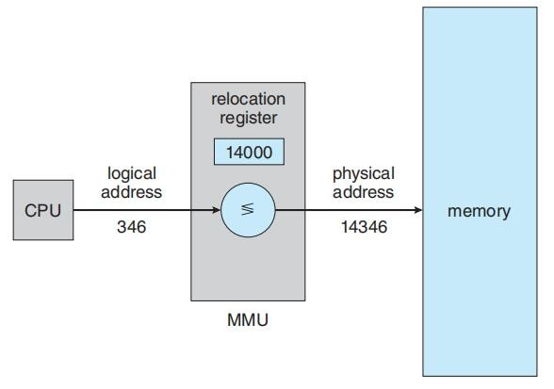
Unit IV – MEMORY MANAGEMENT
Logical and Physical Addresses
The value in the relocation register is added to every address generated by a user process at the time the address is sent to memory as shown in Figure.
For example, if the base is at 14000, then an attempt by the user to address location 0 is dynamically relocated to location 14000; an access to location 346 is mapped to location 14346.

Slide 9
Unit IV – MEMORY MANAGEMENT
Dynamic Loading & Linking
Routine is not loaded until it is called
Better memory-space utilization; unused routine is never loaded
All routines kept on disk in relocatable load format
Useful when large amounts of code are needed to handle infrequently occurring cases
No special support from the operating system is required
Static linking – system libraries and program code combined by the loader into the binary program image
Dynamic linking –linking postponed until execution time
Small piece of code, stub, used to locate the appropriate memory-resident library routine
Stub replaces itself with the address of the routine, and executes the routine
Operating system checks if routine is in processes’ memory address
If not in address space, add to address space
Dynamic linking is particularly useful for libraries

Slide 10
Unit IV – MEMORY MANAGEMENT
Contiguous Memory
The main memory must accommodate both the operating system and various user processes.
Need to allocate main memory in the most efficient way possible.
In early method, of contiguous memory allocation, the memory is usually divided into two partitions:
one for the resident operating system
one for the user processes.
In contiguous memory allocation, each process is contained in a single section of memory that is contiguous to the section containing the next process.
Memory Protection
The relocation register contains the value of the smallest physical address; the limit register contains the range of logical addresses (for example, relocation = 100040 and limit = 74600).
Each logical address must fall within the range specified by the limit register.
The MMU maps the logical address dynamically by adding the value in the relocation register. This mapped address is sent to memory

Slide 11
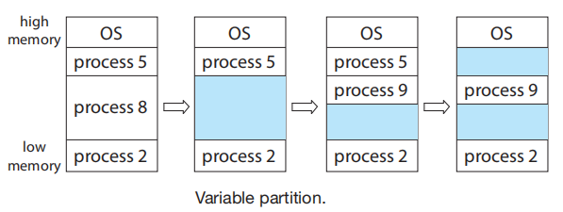
Unit IV – MEMORY MANAGEMENT
Contiguous Memory
2. Memory Allocation
One of the simplest methods for allocating memory is to divide memory into several fixed-sized partitions.
Each partition may contain exactly one process.
The degree of multiprogramming is bound by the number of partitions.
In this multiple partition method, when a partition is free, a process is selected from the input queue and is loaded into the free partition.
When the process terminates, the partition becomes available for another process.
In the variable-partition scheme, the operating system keeps a table, indicating which parts of memory are available and which are occupied.
Initially, all memory is available for user processes and is considered one large block of available memory, a hole. Eventually, memory contains a set of holes of various sizes.

Slide 12
Unit IV – MEMORY MANAGEMENT
Contiguous Memory
As processes enter the system, they are put into an input queue. The operating system takes into account
The memory requirements of each process
The amount of available memory space in determining which processes are allocated memory.
When a process is allocated space,
It is loaded into memory, and it can then compete for CPU time.
When a process terminates, it releases its memory, which the operating system may then fill with another process from the input queue.
In general, the memory blocks available comprise a set of holes of various sizes scattered throughout memory.
When a process arrives and needs memory,
The system searches the set for a hole that is large enough for this process.
If the hole is too large, it is split into two parts.
When a process terminates, it releases its block of memory, which is then placed back in the set of holes.
If the new hole is adjacent to other holes, these adjacent holes are merged to form one larger hole.

Slide 13
Unit IV – MEMORY MANAGEMENT
Contiguous Memory
Dynamic storage allocation problem, concerns how to satisfy a request of size n from a list of free holes.
The first-fit, best- fit, and worst-fit strategies are the ones most commonly used to select a free hole from the set of available holes.
First fit.
Allocate the first hole that is big enough.
Searching can start either at the beginning of the set of holes or at the location where the previous first-fit search ended.
can stop searching as soon as we find a free hole that is large enough.
Best fit.
Allocate the smallest hole that is big enough.
Must search the entire list, unless the list is ordered by size.
This strategy produces the smallest leftover hole.
Worst fit.
Allocate the largest hole. Must search the entire list, unless it is sorted by size.
This strategy produces the largest leftover hole, which may be more useful than the smaller leftover hole from a best-fit approach.

Slide 14
Unit IV – MEMORY MANAGEMENT
Contiguous Memory - Fragmentation
External fragmentation exists when there is enough total memory space to satisfy a request but the available spaces are not contiguous: storage is fragmented into a large number of small holes.
In the worst case,
There may be a block of free (or wasted) memory between every two processes.
If all these small pieces of memory were in one big free block instead, we might be able to run several more processes.
This property is known as the 50-percent rule.
Memory fragmentation can be internal as well as external.
Consider a multiple-partition allocation scheme with a hole of 18,464 bytes.
Suppose that the next process requests 18,462 bytes.
If allocate exactly the requested block, we are left with a hole of 2 bytes.
The overhead to keep track of this hole will be substantially larger than the hole itself.

Slide 15
Unit IV – MEMORY MANAGEMENT
Contiguous Memory - Fragmentation
The general approach to avoiding this problem is
To break the physical memory into fixed-sized blocks and allocate memory in units based on block size.
With this approach, the memory allocated to a process may be slightly larger than the requested memory.
The difference between these two numbers is internal fragmentation. (Unused memory that is internal to a partition).
One solution to the problem of external fragmentation is compaction.
The goal is to shuffle the memory contents so as to place all free memory together in one large block.
Another possible solution to the external-fragmentation problem is to permit the logical address space of the processes to be noncontiguous.

Slide 16
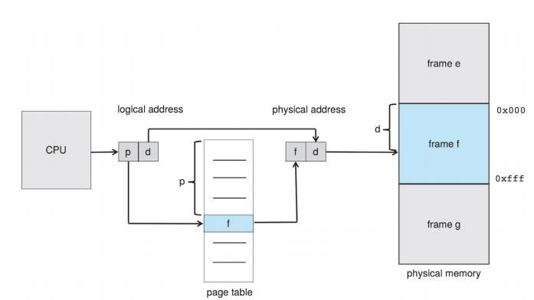

Unit IV – MEMORY MANAGEMENT
Paging
Paging is a memory-management scheme. However, paging avoids external fragmentation and the need for compaction.
Basic Method
The basic method for implementing paging involves breaking physical memory into fixed-sized blocks called frames
Breaking logical memory into blocks of the same size called pages.
When a process is to be executed, its pages are loaded into any available memory frames from their source.
The hardware support for paging is illustrated in Figure 4.5. Every address generated by the CPU is divided into two parts: a page number (p) and a page offset (d).

Slide 17
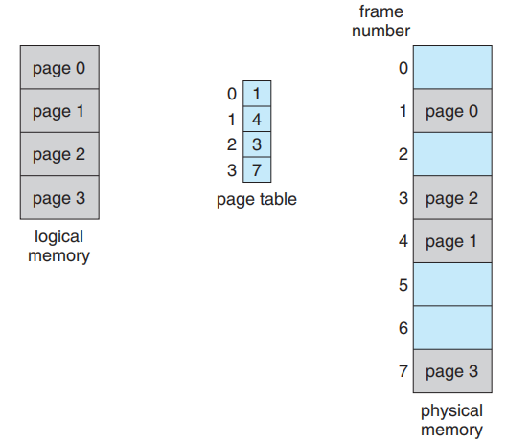
Unit IV – MEMORY MANAGEMENT
Paging
The page number is used as an index into a page table.
The page table contains the base address of each page in physical memory.
This base address is combined with the page offset to define the physical memory address that is sent to the memory unit.
The page size (like the frame size) is defined by the hardware.
The size of a page is a power of 2, varying between 512 bytes and 1 GB per page, depending on the computer architecture.
If the size of the logical address space is 2^{m,} and a page size is 2^{n} bytes, then the high-order m-n bits of a logical address designate the page number, and the n low-order bits designate the page offset. Thus, the logical address is as follows:

Slide 18
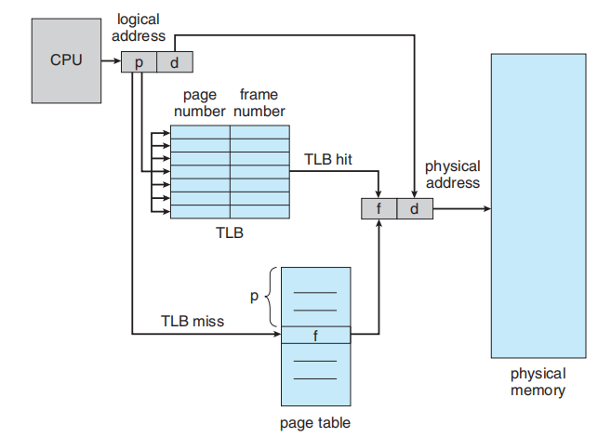
Unit IV – MEMORY MANAGEMENT
Paging – Translation Lookaside Buffer

Slide 19
Unit IV – MEMORY MANAGEMENT
Page Replacement Algorithms
If no frame is free, find a page that is not currently being used and free it.
Free a frame by writing its contents to swap space and changing the page table (and all other tables) to indicate that the page is no longer in memory
Now use the freed frame to hold the page for which the process faulted.
Modify the page-fault service routine to include page replacement:
Find the location of the desired page on the disk.
Find a free frame:
If there is a free frame, use it.
If there is no free frame, use a page-replacement algorithm to select a victim frame.
Write the victim frame to the disk; change the page and frame tables accordingly.
Read the desired page into the newly freed frame; change the page and frame tables.
Continue the user process from where the page fault occurred.
If no frames are free, two page transfers (one out and one in) are required.
This situation effectively doubles the page-fault service time and increases the effective access time accordingly.

Slide 20
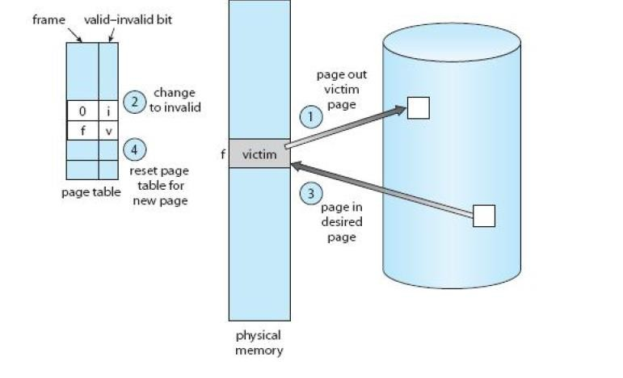
Unit IV – MEMORY MANAGEMENT
Page Replacement Algorithms
Reduce this overhead by using a modify bit (or dirty bit).
When a page is selected for replacement, examine it’s modify bit.
If the bit is set,
the page has been modified since it was read in from the disk.
Must write the page to the disk.
If the modify bit is not set,
the page has not been modified since it was read into memory.
No need to write the memory page to the disk: it is already there.

Slide 21
Unit IV – MEMORY MANAGEMENT
Page Replacement Algorithms
FIFO Page Replacement
The simplest page-replacement algorithm is a first-in, first-out (FIFO) algorithm.
A FIFO replacement algorithm associates with each page the time when that page was brought into memory.
When a page must be replaced, the oldest page is chosen.
For our example reference string, our three frames are initially empty.
The first three references (7, 0, 1) cause page faults and are brought into these empty frames.
The next reference (2) replaces page 7, because page 7 was brought in first.
Since 0 is the next reference and 0 is already in memory, we have no fault for this reference.
The first reference to 3 results in replacement of page 0, since it is now first in line.
Because of this replacement, the next reference, to 0, will reference string fault.

Slide 22
Unit IV – MEMORY MANAGEMENT
Page Replacement Algorithms
Enhanced Second-Chance Algorithm
Enhance the second-chance algorithm by considering the reference bit and the modify bit as an ordered pair.
With these two bits, we have the following four possible classes:
(0, 0) neither recently used nor modified—best page to replace.
(0, 1) not recently used but modified—not quite as good, because the page will need to be written out before replacement.
(1, 0) recently used but clean—probably will be used again soon.
(1, 1) recently used and modified—probably will be used again soon, and the page will be need to be written out to disk before it can be replaced.
Each page is in one of these four classes.
The major difference between this algorithm and the simpler clock algorithm is that here we give preference to those pages that have been modified in order to reduce the number of I/Os required.

Slide 23
Unit IV – MEMORY MANAGEMENT
Page Replacement Algorithms
COUNTING-BASED PAGE REPLACEMENT
keep a counter of the number of references that have been made to each page and develop the following two schemes.
Least frequently used (LFU)
The least frequently used (LFU) page-replacement algorithm requires that the page with the smallest count be replaced.
The reason for this selection is that an actively used page should have a large reference count.
A problem arises, however, when a page is used heavily during the initial phase of a process but then is never used again.
Since it was used heavily, it has a large count and remains in memory even though it is no longer needed.
One solution is to shift the counts right by 1 bit at regular intervals, forming an exponentially decaying average usage count.

Slide 24
Unit IV – MEMORY MANAGEMENT
Page Replacement Algorithms
COUNTING-BASED PAGE REPLACEMENT
Most Frequently Used (MFU)
The most frequently used (MFU) page-replacement algorithm is based on the argument that the page with the smallest count was probably just brought in and has yet to be used.
The implementation of these algorithms is expensive, and they do not approximate OPT replacement

Slide 25
Unit IV – MEMORY MANAGEMENT
Allocation of Frames
Allocation Algorithms
The easiest way to split m frames among n processes is to give everyone an equal share, m/n frames (ignoring frames needed by the operating system for the moment).
Ex: If there are 93 frames and five processes, each process will get 18 frames.
The three leftover frames can be used as a free-frame buffer pool. This scheme is called equal allocation.
An alternative is to recognize that various processes will need differing amounts of memory.
Consider a system with a 1-KB frame size. If a small student process of 10 KB and an interactive database of 127 KB are the only two processes running in a system with 62 free frames, it does not make much sense to give each process 31 frames. The student process does not need more than 10 frames, so the other 21 are, strictly speaking, wasted. To solve this problem, we can use proportional allocation, in which we allocate available memory to each process according to its size. Let the size of the virtual memory for process pi be si, and define
S =Σsi
Then, if the total number of available frames is m, we allocate ai frames to process pi, where ai is approximately ai = si /S × m.

Slide 26
Unit IV – MEMORY MANAGEMENT
Allocation of Frames
Allocation Algorithms
Example:
With proportional allocation, split 62 frames between two processes,
Process 1 = 10 pages and
Process 2 = 127 pages
ai = si /S × m.
S =Σsi
Process 1 = 10/137 × 62 ≈ 4, and Process 2 = 127/137 × 62 ≈ 57.
In this way, both processes share the available frames according to their “needs,” rather than equally.

Slide 27
Unit IV – MEMORY MANAGEMENT
Allocation of Frames
Allocation Algorithms
Global versus Local Allocation
Page-replacement algorithms are classified into two broad categories: global replacement and local replacement
Difference:
Global Replacement | Local Replacement
one process can take a frame from another. | each process select from only its own set of allocated frames
process cannot control its own page-fault rate. | the set of pages in memory for a process is affected by the paging behavior of only that process

Slide 28
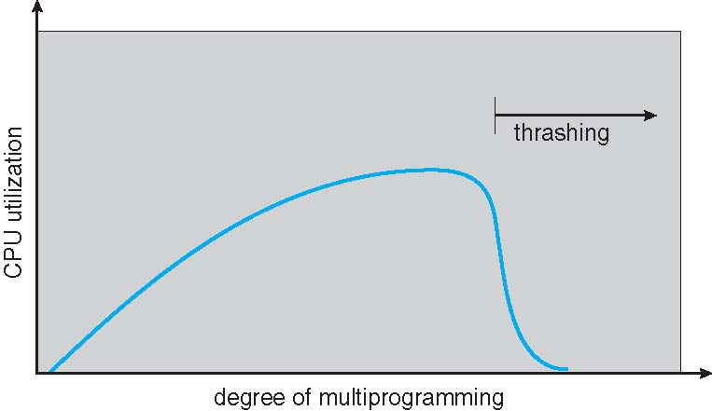
Unit IV – MEMORY MANAGEMENT
Thrashing
Thrashing is a phenomenon that occurs in computer systems when the system spends an excessive amount of time on page swapping rather than executing useful work.
Thrashing - a process is busy swapping pages in and out
If a process does not have “enough” pages, the page-fault rate is very high
Page fault to get page
Replace existing frame
But quickly need replaced frame back
This leads to:
Low CPU utilization
Operating system thinking that it needs to increase the degree of multiprogramming
Another process added to the system
To prevent thrashing two techniques are there
Working set model
Page-fault Frequency

Slide 29
Unit IV – MEMORY MANAGEMENT
Thrashing
Working Set Model:
Works on the principle Locality of Reference
Locality of Reference:
When set of instructions executed repeatedly for certain period of time.
Δ ≡ working-set window ≡ a fixed number of page references Example: 10,000 instructions
Each Function is taken as a working set as it is one locality
WSS_{i} (working set of Process P_{i}) = total number of pages referenced in the most recent Δ (varies in time)
if Δ too small
Working set contains less number of active pages.
It is not covering all the localities .
More number of page fault occurs.
if Δ too large will encompass several localities
Contains more number of active pages
if Δ = ∞ ⇒ will encompass entire program
if D > m ⇒ Thrashing
Policy if D > m, then suspend or swap out one of the processes

Slide 30
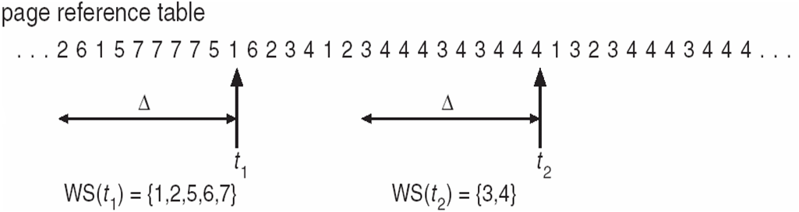
Unit IV – MEMORY MANAGEMENT
Thrashing
Working Set Model:
2. Page Fault Frequency
Establish “acceptable” page-fault frequency (PFF) rate and use local replacement policy
If actual rate too low, process loses frame
If actual rate too high, process gains frame

Slide 31
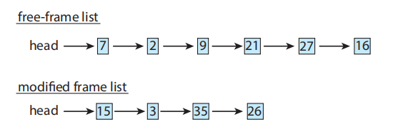
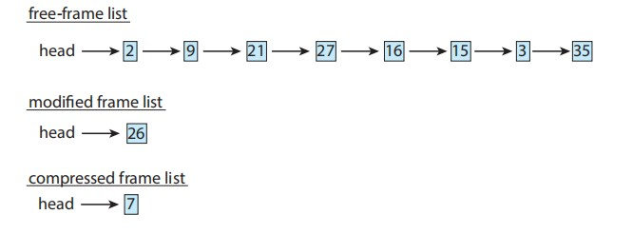
Unit IV – MEMORY MANAGEMENT
Memory Compression
An alternative to paging is memory compression.
Here, rather than paging out modified frames to swap space, compress several frames into a single frame
enabling the system to reduce memory usage without resorting to swapping pages.
compress a number of frames—say, three—and store their compressed versions in a single page frame.
frame 7 is removed from the free-frame list.
Frames 15, 3, and 35 are compressed and stored in frame 7, which is then stored in the list of compressed frames.
The frames 15, 3, and 35 can now be moved to the free-frame list.
If one of the three compressed frames is later referenced, a page fault occurs, and the compressed frame is decompressed, restoring the three pages 15, 3, and 35 in memory.

Slide 32
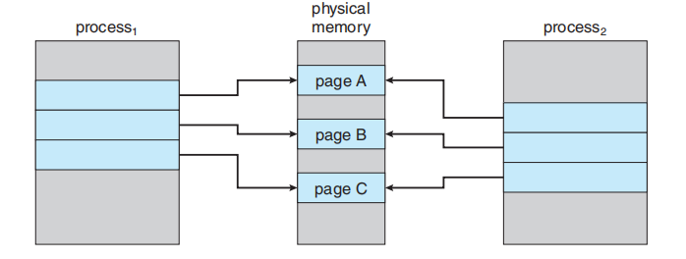
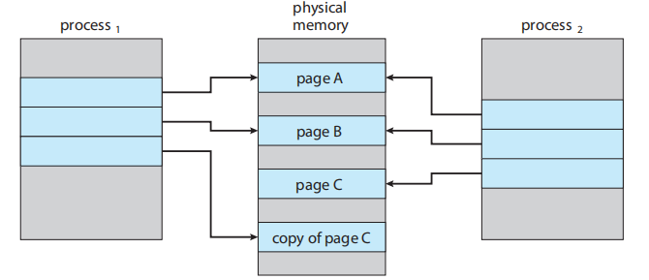
Unit IV – MEMORY MANAGEMENT
Copy-on-Write
Copy-on-Write
fork() system call creates a child process that is a duplicate of its parent.
a technique, which works by allowing the parent and child processes initially to share the same pages.
These shared pages are marked as copy-on-write pages, meaning that if either process writes to a shared page, a copy of the shared page is created.
Copy-on-write is illustrated in Figures which shows the contents of the physical memory before and after process 1 modifies page C

Slide 33
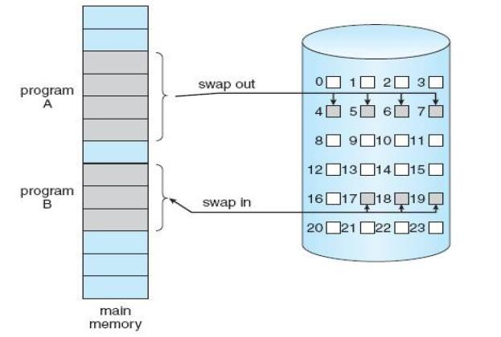
Unit IV – MEMORY MANAGEMENT
Copy-on-Write
Demand Paging
Demand paging is commonly used in virtual memory systems.
With demand-paged virtual memory, pages are loaded only when they are demanded during program execution.
Pages that are never accessed are thus never loaded into physical memory.
A demand-paging system is similar to a paging system with swapping where processes reside in secondary memory (usually a disk).
When we want to execute a process, we swap it into memory

